Slide 1
Approximation Solution
Abigail Ensogna

Slide 2
Approach
def approximate(adj_list):
smallest = float('inf') # minimum threshold
best = [] # will store best found tour
v = [all vertex labels]
for i in # of shuffles:
curr = copy of all vertices
shuffle curr # shuffle - randomizing start tour
append start node to tour
dist, order = best_permutation(adj_list, curr)
if smaller weight found:
smallest = dist
best = order
return smallest, best
def best_permutation(adj_list, vertices):
weight = get_weight(adj_list, vertices)
permutation = vertices
for v in vertices:
for u in vertices:
if u != v:
swap u and v
total = get_weight(adj_list, vertices)
if better tour found:
weight = total
permutation = copy of vertices
swap u and v back
return total, permutation

Slide 3
Runtime Analysis
def best_permutation(adj_list, vertices):
weight = get_weight(adj_list, vertices)
permutation = vertices
for v in range(1, len(vertices)-1): # O(n)
for u in range (v+1, len(vertices)-1): # O(n)
if u != v:
left = vertices[u]
right = vertices[v]
vertices[v] = left
vertices[u] = right
total = get_weight(adj_list, vertices) # O(n)
if total < weight:
weight = total
permutation = vertices.copy() # O(n)
left = vertices[u]
right = vertices[v]
vertices[v] = left
vertices[u] = right
return total, permutation
def approximate(adj_list):
smallest = float('inf')
best = []
vnum = len(adj_list)
v = [k for k in adj_list.keys()]
for i in range(args.shuffle):
curr = v.copy() # O(n)
random.shuffle(curr)
curr.append(curr[0])
dist, order = best_permutation(adj_list, curr) # O(n³)
if dist < smallest:
smallest = dist
best = order
return smallest, best
Worst Case: O (shuffle * n³) = O (n³)

Slide 4
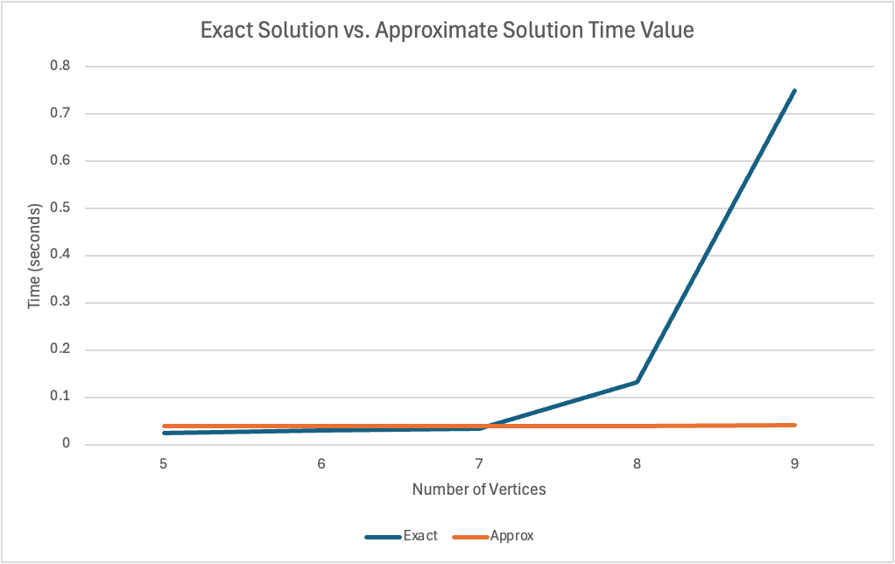
Wall Clock Analysis

Slide 5
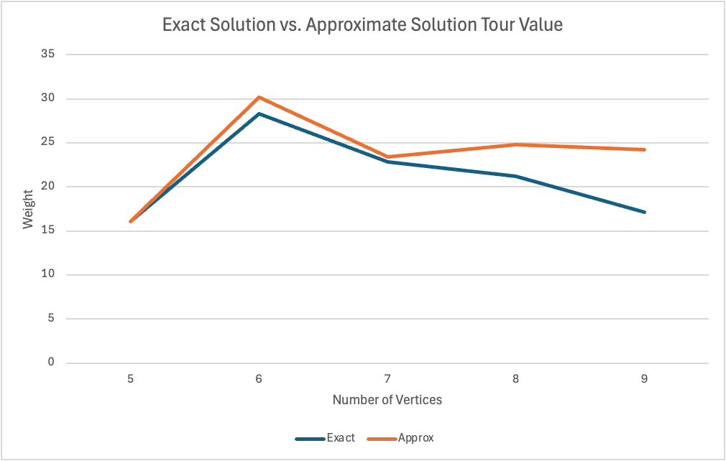
Value Analysis

